Slide 1
Section 4.2
Linear Models:
Building Linear Functions from Data
Copyright © 2012 Pearson Education, Inc. Publishing as Prentice Hall.

Slide 2
Copyright © 2012 Pearson Education, Inc. Publishing as Prentice Hall.

Slide 3

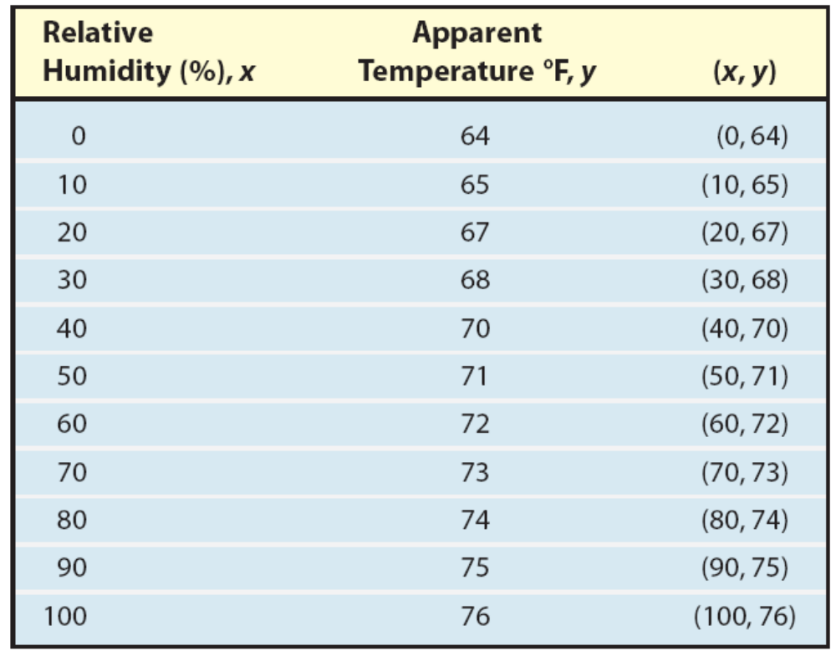
Copyright © 2012 Pearson Education, Inc. Publishing as Prentice Hall.

Slide 4
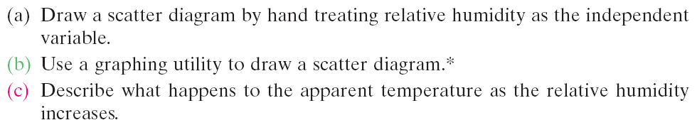
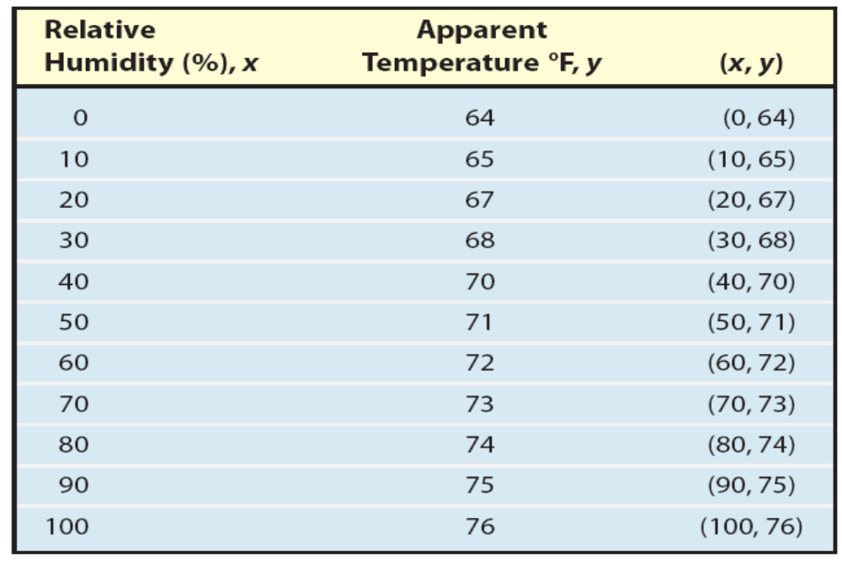
Copyright © 2012 Pearson Education, Inc. Publishing as Prentice Hall.

Slide 5
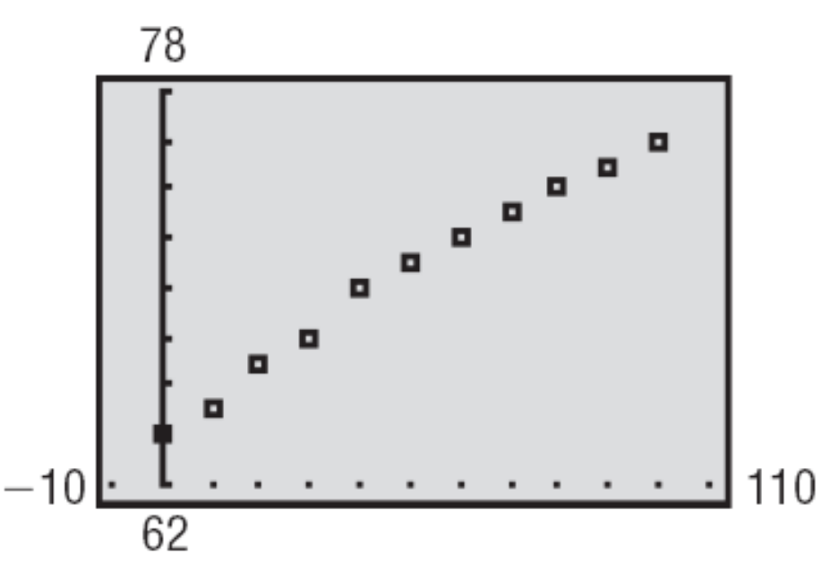
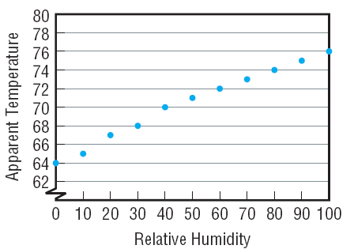
As the relative humidity increases, the apparent temperature also increases.
Copyright © 2012 Pearson Education, Inc. Publishing as Prentice Hall.

Slide 6
Copyright © 2012 Pearson Education, Inc. Publishing as Prentice Hall.

Slide 7
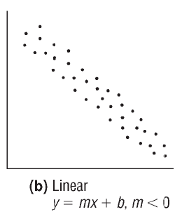
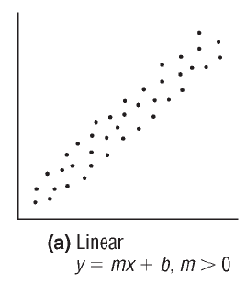
Copyright © 2012 Pearson Education, Inc. Publishing as Prentice Hall.

Slide 8
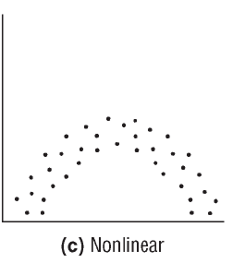
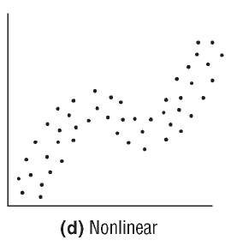
Copyright © 2012 Pearson Education, Inc. Publishing as Prentice Hall.

Slide 9
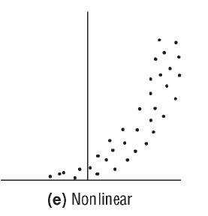
Copyright © 2012 Pearson Education, Inc. Publishing as Prentice Hall.

Slide 10
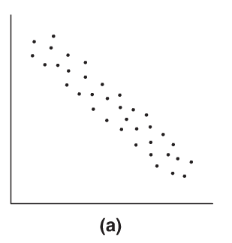
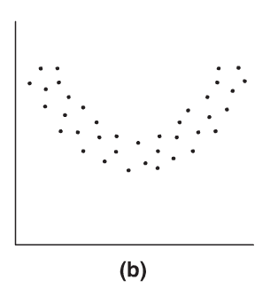
Determine whether the relationship between the two variables is linear or nonlinear.
Linear
Nonlinear
Copyright © 2012 Pearson Education, Inc. Publishing as Prentice Hall.

Slide 11
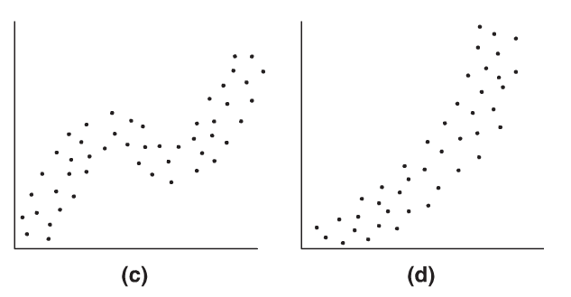
Determine whether the relationship between the two variables is linear or nonlinear.
Nonlinear
Nonlinear
Copyright © 2012 Pearson Education, Inc. Publishing as Prentice Hall.

Slide 12
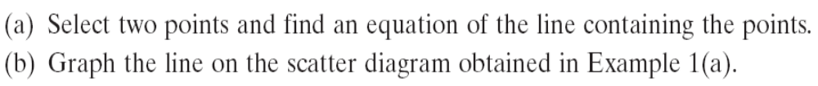
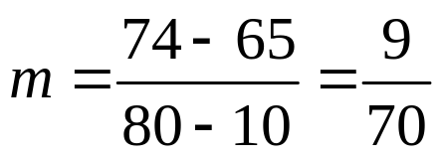

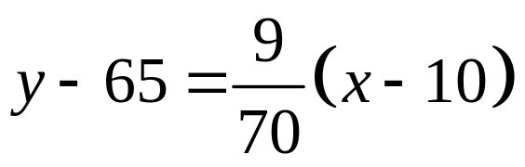
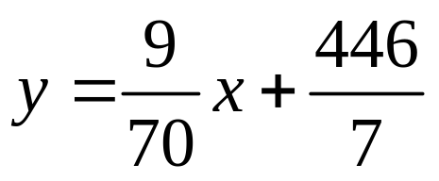
Copyright © 2012 Pearson Education, Inc. Publishing as Prentice Hall.

Slide 13
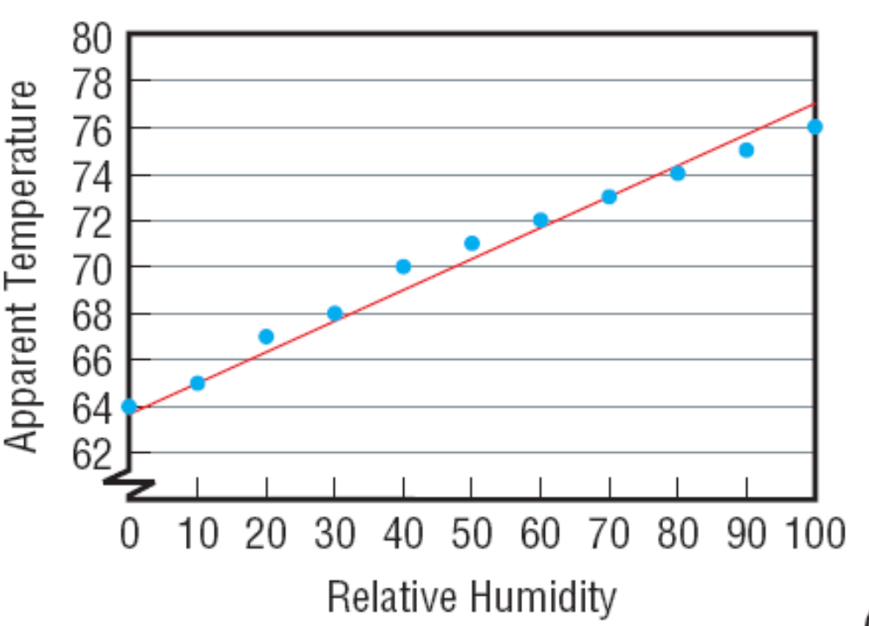
Copyright © 2012 Pearson Education, Inc. Publishing as Prentice Hall.

Slide 14
Copyright © 2012 Pearson Education, Inc. Publishing as Prentice Hall.

Slide 15
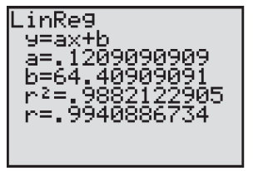
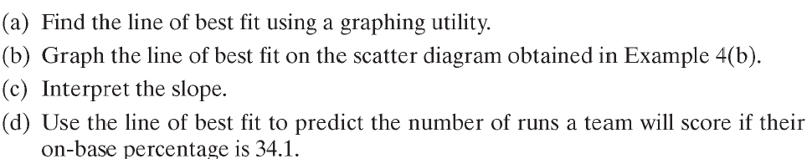
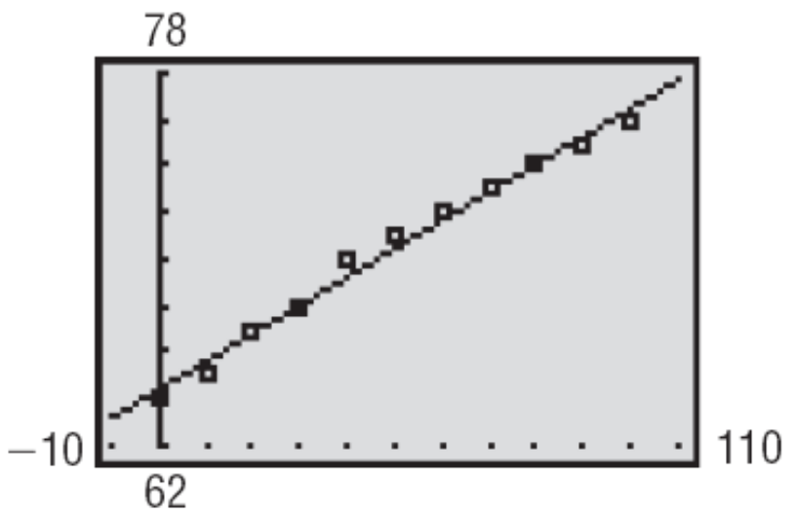
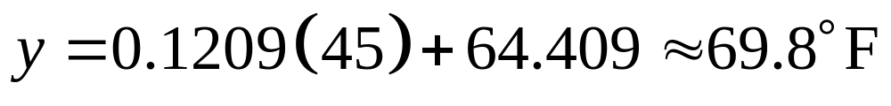
Using the data from the previous example:
The slope is .1209 which means the apparent temperature rises .1209° for every 1% increase in relative humidity.
(d) Use the line of best fit to predict the apparent temperature when actual temperature is 72°F and relative humidity is 45%.
Copyright © 2012 Pearson Education, Inc. Publishing as Prentice Hall.

